Slide 1
529 Advance Data Analytics Mid-term Project
March 22, 2016
Arpita Kaushik
A20336287

Slide 2
Table of Content
Business Scenario
Business Objective
Source Dataset
Identifying Variables
Libraries Used in R
Exploratory Data Analysis Results
Regression Modeling Results
Summary/Conclusions

Slide 3
Business Scenario
In a one-click shopping world with on-demand everything, the life insurance application process is antiquated. Customers provide extensive information to identify risk classification and eligibility, including scheduling medical exams, a process that takes an average of 30 days.
The result? People are turned off. That’s why only 40% of U.S. households own individual life insurance. Prudential wants to make it quicker and less labor intensive for new and existing customers to get a quote while maintaining privacy boundaries. By developing a predictive model that accurately classifies risk using a more automated approach, you can greatly impact public perception of the industry.

Slide 4
Business Objective
The objective is to develop a predictive model that accurately classifies risk using a more automated approach. The Risk denotes the chances for a person to claiming his/her life insurance policy from the company. The Risk level helps Prudential Life insurance in providing an exact Quote of Life Insurance for each individual.
This will greatly help in public perception of the industry.
The results will help Prudential better understand the predictive power of the data points in the existing assessment, and make the Life insurance process quicker and less labor intensive.

Slide 5
Source Data set
File Name: Train.csv
Source of Data: https://www.kaggle.com/c/prudential-life-insurance-assessment/data
Total No of Rows: 59381
Total No of Variables: 128
Time Period: NA (The time period is not mentioned on the source website)

Slide 6
Identifying Variable – Dependant Variable (Y)
Dependant Variable (Y): The ‘Response’ field in the dataset is the dependant variable. ‘Response’ variable denotes the level of risk associated with a person’s chances of claiming his/her life insurance, in order to get a life Insurance Quote. This helps the Insurance company in assessing the application and denoting the right quote for the applicant. The several levels for ‘Response’ variable are: 1,2,3,4,5,6,7,8, where 8 means the highest level of risk. For example, if insurance risk level is calculated as 8 for an individual, he/she has maximum chances of claiming insurance from the company, Therefore a level of 8 is bad for the insurance company.
Name | Type | Levels
Response | Categorical | 1,2,3,4,5,6,7,8

Slide 7
Identifying Variable – Predictor Variable (X)
Predictor Variable(X): Following is the list of possible Predictor Variable -
S.No | Name | Description | No. of variables | Type
1 | Ins_Age | Age of the applicant | 1 | Numeric
2 | Ht | Height | 1 | Numeric
3 | Wt | Weight | 1 | Numeric
4 | BMI | BMI ratio | 1 | Numeric
5 | Product_Info_1 to 7 | Insurance Product Information | 7 | Categorical;
6 | Employment_Info_2, 3,5 | Employment Info of the Applicant | 3 | Categorical
7 | Employment_Info_1,4,6 |  | 3 | Numeric
8 | InsuredInfo_1 to 7 | Insurance Information | 7 | Categorical
9 | Insurance_History_1, 2, 3 ,4 ,7, 8, 9 | Applicant’s Insurance History | 7 | Categorical
10 | Family_Hist_1 | Family Medical History Indicator | 1 | Categorical
11 | Family_Hist_2,3,4,5 |  | 4 | Numeric
12 | Medical_History_2 ,3, 4,5 ,6 ,7 ,8, 9, 11, 12, 13, 14, 16 ,17 ,18,19,20, 21, 22, 23, 25,26,27,28,29,30,31, 33 to 41 | Medical & Accident History of applicant | 36 | Categorical
13 | Medical_History_1, 10, 15, 24, 32 |  | 5 | Discrete
14 | Medical_Keyword_1 to 48 | Medical Keyword | 48 | Categorical
Total |  |  | 126
Total Number of Categorical Variable→115
Total Number of Continues Variable → 11
Note: ‘Employment_Info2,3,5’ denotes 3 variables – Employment_Info2, Employment_Info3, Employment_Info5. Same is the case for other variables. As the total number of variables is huge, they are denoted in such a way

Slide 8
R Libraries
Following are some of the libraries which will be used in this analysis
library(nnet)
Used to build the multinomial logistic model
Uses the predictor variables to build a model which fits value for the Response variable
library(xlsx)
To extract xls file into R
Use to create the final output file in an excel sheet

Slide 9
Exploratory Analysis – a) Missing Values
There are two dataset present in this problem statement – Train & Test. Following is the brief about both
In order to explore the data and develop a good regression model, 3 factors need to be understood :
Missing Values: 4 variables found to have missing values. The missing values are replaced with the ‘mean value’ of that column. The mean for the rows having not null value is calculated and updated where the value is missing.
Train Data set
a) Contains the Response variable
b) Used to build the Predictive model
"Test" Data set
a) Does not contain the Response variable
b) Need to predict Response variable for this dataset using "Train" data
The percentage of missing value is quite high. Even if the missing value is treated it will not add any value to the model. Therefore, these variables can be excluded from the analysis
Name of the field | % of value missing | Mean Value for the Column
Family_Hist_2 | 40% | 0.4745
Family_Hist_3 | 55% | 0.4977
Family_Hist_4 | 32% | 0.4448
Employement_Info_6 | 1.80% | 0.3614

Slide 10
Exploratory Analysis – b)Association – Categorical Variables 1
Association – Categorical Variables:
The relation of Response variable with the possible predictor variables. Statistical techniques such as frequency tables and Chi-square test can be used to determine if the Response variable is dependant on any of the possible predictor.
The list of possible predictors are listed in Slide No-6 to 8. Out of these 115 are Categorical Variables
The next few slides will display the results of the Frequency table and Chi square analysis

Slide 11
Exploratory Analysis – b)Association – Categorical Variables 2
Out of 115 categorical variables, only 43 qualified the Chi-square test and have P-value less than 0.05. Following is the table which represent the P-value for each variable
S.No | Variable Name | P-value | X-Square | Include in the model ?
1 | Product_Info_3 | less than 0.00000022 | 1396.346 | YES
2 | Employment_Info_2 | less than 0.00000022 | 2020.217 | YES
3 | InsuredInfo_2 | less than 0.00000022 | 505.802 | YES
4 | InsuredInfo_5 | less than 0.00000022 | 671.289 | YES
5 | InsuredInfo_7 | less than 0.00000022 | 645.344 | YES
6 | Insurance_History_2 | less than 0.00000022 | 974.847 | YES
7 | Medical_History_4 | less than 0.00000022 | 8650.182 | YES
8 | Medical_History_5 | less than 0.00000022 | 428.709 | YES
9 | Medical_History_6 | less than 0.00000022 | 1751.021 | YES
10 | Medical_History_16 | less than 0.00000022 | 1321.022 | YES
11 | Medical_History_17 | less than 0.00000022 | 371.715 | YES
12 | Medical_History_20 | less than 0.00000022 | 426.786 | YES
13 | Medical_History_23 | less than 0.00000022 | 7671.093 | YES
14 | Medical_History_29 | less than 0.00000022 | 557.857 | YES
15 | Medical_History_30 | less than 0.00000022 | 1193.164 | YES
16 | Medical_History_31 | less than 0.00000022 | 157.566 | YES
17 | Medical_History_33 | less than 0.00000022 | 1243.626 | YES
18 | Medical_History_38 | less than 0.00000022 | 213.562 | YES
19 | Medical_History_39 | less than 0.00000022 | 3380.567 | YES
20 | Medical_History_40 | less than 0.00000022 | 1287.575 | YES
21 | Medical_Keyword_1 | less than 0.00000022 | 547.581 | YES

Slide 12
Exploratory Analysis – b)Association – Categorical Variables 3
S.No | Variable Name | P-value | X-Square | Include in the model ?
22 | Medical_Keyword_3 | less than 0.00000022 | 4563.913 | YES
23 | Medical_Keyword_4 | less than 0.00000022 | 100.788 | YES
24 | Medical_Keyword_9 | less than 0.00000022 | 114.937 | YES
25 | Medical_Keyword_10 | less than 0.00000022 | 252.344 | YES
26 | Medical_Keyword_13 | 0.0000023 | 73.894 | YES
27 | Medical_Keyword_14 | 0.000013 | 65.313 | YES
28 | Medical_Keyword_15 | less than 0.00000022 | 6966.228 | YES
29 | Medical_Keyword_16 | less than 0.00000022 | 183.087 | YES
30 | Medical_Keyword_19 | less than 0.00000022 | 90.726 | YES
31 | Medical_Keyword_22 | less than 0.00000022 | 257.488 | YES
32 | Medical_Keyword_23 | less than 0.00000022 | 1245.459 | YES
33 | Medical_Keyword_24 | less than 0.00000022 | 418.860 | YES
34 | Medical_Keyword_25 | less than 0.00000022 | 1084.311 | YES
35 | Medical_Keyword_27 | less than 0.00000022 | 165.147 | YES
36 | Medical_Keyword_31 | less than 0.00000022 | 159.733 | YES
37 | Medical_Keyword_33 | less than 0.00000022 | 205.787 | YES
38 | Medical_Keyword_35 | less than 0.00000022 | 191.69 | YES
39 | Medical_Keyword_36 | less than 0.00000022 | 86.001 | YES
40 | Medical_Keyword_38 | less than 0.00000022 | 719.748 | YES
41 | Medical_Keyword_43 | less than 0.00000022 | 244.754 | YES
42 | Medical_Keyword_46 | less than 0.00000022 | 219.528 | YES
43 | Medical_Keyword_48 | less than 0.00000022 | 1745.683 | YES

Slide 13
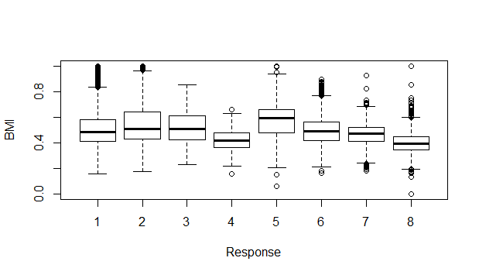
Exploratory Analysis – b) Correlation - Continues Variable 1
Correlation – Categorical Variables:
Out of 11 Continues variables, following 2 displayed a trend with the response variable
BMI
Employment Info 6
Following is the Box plot for Response variable and BMI, to understand the relation between them
The line highlighted in Red displays the trend between BMI & Response.
As there is a trend for Response this variable can be included in the analysis

Slide 14
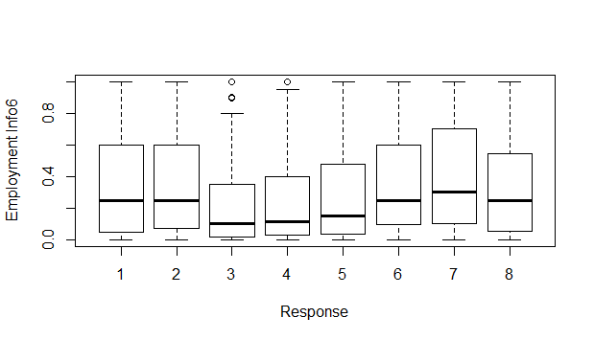
Exploratory Analysis – b) Correlation - Continues Variable 2
Following is the Box plot for Response variable and Employment Info 6, to understand the relation between them
The trend between the Response and Employment Info is denoted by the red line.
As Employment Info has varied valued for each response category, it can be included in model

Slide 15
Exploratory Analysis – b) Correlation - Continues Variable 3
List of table specifying which all continues variable to be included in the model
Out of 11 continues variable, only 2 denoted a trend against the Response variable, therefore only these 2 are included in the model
Hence, out of a total of 126 variables, 45 are included in the model (43 categorical and 2 continues)
Variable Name | Is there a Trend ? | Include in the model ?
Employment_Info_6 | YES | YES
BMI | YES | YES
Ins_Age | NO | NO
Wt | NO | NO
Ht | NO | NO
Family_Hist_2 | NO | NO
Family_Hist_3 | NO | NO
Family_Hist_4 | NO | NO
Family_Hist_5 | NO | NO
Employment_Info_1 | NO | NO
Employment_Info_4 | NO | NO

Slide 16
Regression Modeling Results – Building the Model
For this analysis, Multinomial Regression model is used. Multinomial Regression Model, is used to build a regression model where the response variable has more than two category. It is a generalization of the Logistic regression model.
After exploring the data by identifying the best predictor variable and finding out the appropriate regression modeling technique. Next step is to build the model.
The ‘multinom()’ function is used to build a regression model in R

Slide 17
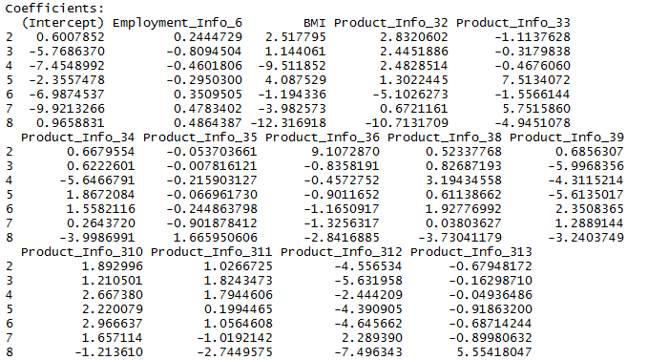
Regression Modeling Results – Analyzing the Model
Following is the part of output for the summary of model
The below screen shot denotes the Intercepts and coefficients for some of the variables in the model
The highest coefficient for BMI is for Response variable level – 8
The highest coefficient for Employment_Info_6 is for Response variable level-3
Therefore it can be concluded that BMI has highest impact on Level-8 of the Response variable. And Employement_Info_6 has highest impact on Level-3 of the response variable.
NOTE: Level of the Response variable denotes the different levels which are present for ‘Response Variable’(1 to 8). Also as the number of variables are too many, only few which have a huge impact are highlighted.

Slide 18
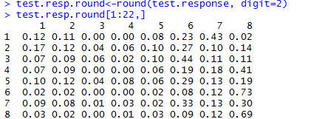
Regression Modeling Results – Predicting values
After the model is fitted, probability is calculated for each response type. The function ‘predict()’ is used to calculate the probability using the model on Test datase
A part of the output of the ‘predict()’ is a matrix, as displayed below:
The first row highlighted in blue is the Response variable, for which the probability needs to be calculated
The remaining rows denotes the probability, of each level of response, for that particular record.
The ‘Response’ level having the highest probability will be the final predicted ‘Response’ for each row. ’ For example for row no.3 the maximum probability is 0.44 hence the predicted Response will be 6.

Slide 19
Conclusion
The ‘Response’ variable for Test data set was predicted successfully using the following 45 predictors variables(43 Categorical & 2 Continues):
BMI
Employment Info6
Product Info3
Insured Info2,5,7
Medical History 4,5,6,16,17,20,23,29,30,31,33,38,39,40
Medical Keyword 1,3,4,9, 10,13,14,15,16,19,22,23,24,2527,31,33,35,36,38,43,46,48
Note: ‘Insurance_Info2,5,7’ denotes 3 variables – Insurance_Info2, Insurance_Info5, Insurance_Info7. Same is the case for other variables. As the total number of variables is huge, they are denoted in such a way
The response variable denotes the level of risk associated with the Life insurance of a particular individual. Most frequent value for Response is ‘8’ in the test data. Therefore the most occurring risk is level 8 for the output data set.
Multinomial Regression model is effective to perform predictive modeling when the response variable is multi-level categorical.
The model denotes probability of each level of Response variable. This helps in identifying which all levels(not just the highest) are more probable for a record type.

